Slide 1

RHP 9 “Raise the Floor”
PDSA Cycles Webinar #2
June 10, 2015

Slide 2
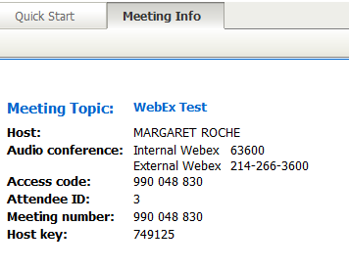
Call-in for Audio
Call In #214-266-3600
Meeting # 998 218 442
Meeting Password: 1115
Attendee ID#

Slide 3
Housekeeping
Your phones are currently on mute and will be released after the presentation for Q&A
For Attendance, please submit your name via the chat function located on the right hand side of your screen
During the presentation, you can submit your questions to the host through the chat box to the right of your screen.
Do not place phones on Hold, USE MUTE
This session is being recorded for the purpose of sharing information with others who could not attend.
Presentation and PDSA documents will be emailed to participants after the webinar.

Slide 4
How to begin?
Ask 3 Questions:
What are we trying to accomplish? (AIM)
How will we know that a change is an improvement? (MEASURE)
What change can we make that will result in improvement? (CHANGE)
Act
Plan
Study
Do
Reference: Langley, Nolan, Nolan, Norman, & Provost. The Improvement Guide
Notes:
Nolan’s model--three questions and PDSA, but not just one PDSA. Difference between this and Juran is the emphasis on repeated PDSA cycles

Slide 5
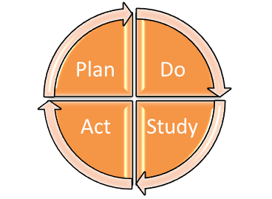
PDSA
Plan Do Study Act
Deming wheel / Shewhart cycle
Also PDCA (Plan-Do-Check-Act)
Systematic method for improvement
Iterative for continual improvement
Promotes small scale rapid cycle improvement over a short period of time
Avoids: Ready, Fire, Aim

Slide 6
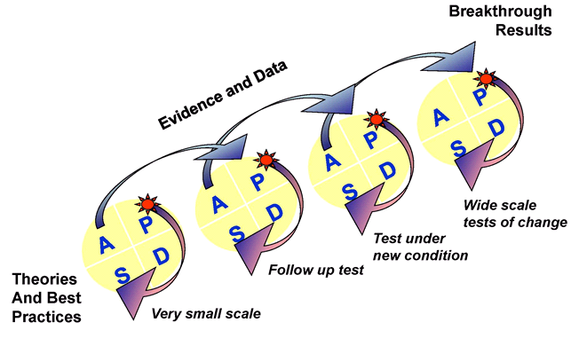
Continuous Improvement

Slide 7
PDSA
Improvement method:
  Plan: developing a plan to test the change
  Do: carrying out the test
  Study: observing and learning from the consequences
  Act: determining what modifications should be made to the test

Slide 8
Presenters
Pranavi Sreeramoju, MD, MPH, CMQ, FSHEA
  Associate Professor, Medicine-Infectious Disease
  Chief of Infection Prevention – Parkland
  UT Southwestern Medical Center, Dallas, TX
  Pranavi.Sreeramoju@UTSouthwestern.edu
Maria J. Sierra, RNC
  Quality Care OPCT Transitional Care
  Parkland Health & Hospital System
  MARIA.SIERRA@phhs.org
Mavis Mashingaidze, Phd, MsPH, MBA, BSN, RN
  OPAT Transitional Care Nurse
  4th Floor Medicine Specialty – ID OPAT Clinic
  Parkland Health & Hospital System
  Mavis.mashingaidze@phhs.org

Slide 9
RITE Program
1115 Waiver Project 2.6
RHP9 ‘Raise the Floor’ Webinar
Pranavi Sreeramoju, MD, MPH, CMQ, FSHEA
Chief of Infection Prevention, Parkland Health and Hospital System
Associate Professor of Medicine, UT Southwestern Medical Center
June 10th, 2015

Slide 10


RITE Program
Reduce Infections Together in Everyone
Notes:
Need high res image

Slide 11
RITE Program
A Parkland project funded through the 1115 waiver program
Duration: October 1, 2012 to September 30, 2016
To apply Process Improvement (PI) methodologies to reduce Potentially Preventable Complications (PPC)

Slide 12
Aims
Close 5% performance gap in FY15 and 10% performance gap in FY16 compared to baseline year (FY13) at Parkland for:
CLABSI among patients in ICUs and Wards
CAUTI among patients in ICUs and Wards
SSI among 18 procedures
Adherence to Sepsis Management Bundle in patients with Sepsis POA in ED

Slide 13
The ‘Change Strategy’
Reduce Variation in Processes of Care
Engage Clinicians & Stakeholders
Standardize Curriculum and Training
Have Bi-weekly Learning Sessions
Train At Least 500 Champions in Process Improvement Methodologies
Participate in Regional Collaborative

Slide 14
Basic Project Outline
FY13
FY14
FY15
FY16
PLAN: Identify Variation Finalize Baseline Measurement | DO: All Except Standardized Curriculum Ongoing Measurement | STUDY: Evaluate Outcome Results Measure Process Adherence Administer Standardized Curriculum | ACT: Fine-tune and Improve Performance for all Program Metrics

Slide 15
PLAN
Workgroups Formed and Charters Established
Final approval from CMS/ HHSC came two months before Baseline Year ended
Clinician Surveys Done Electronically
Clinician Interviews Done Face-to-Face
PI Methodologies Training Content Developed

Slide 16
DO
1. Implemented
    2013 peri-operative antibiotic prophylaxis guidelines using order sets, and other measures for SSI prevention
    Early warning alerts for sepsis and sepsis order sets
    Increased awareness regarding central line infection prevention measures, and implemented disinfector caps and standardized dressing change kits
    Increased awareness and education on urinary catheter insertion and maintenance best practices
2. Extracted data reports from electronic medical record to measure utilization or order sets and processes established to improve rates of infections (e.g., timing of perioperative antibiotics, utilization of sepsis order set)
3. Increased awareness about Best Practice Alerts in electronic medical record on presence of central venous catheters and urinary catheters

Slide 17
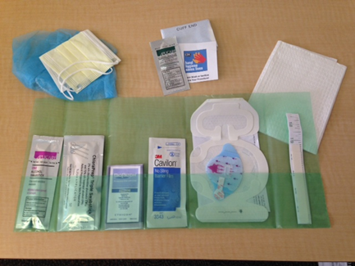
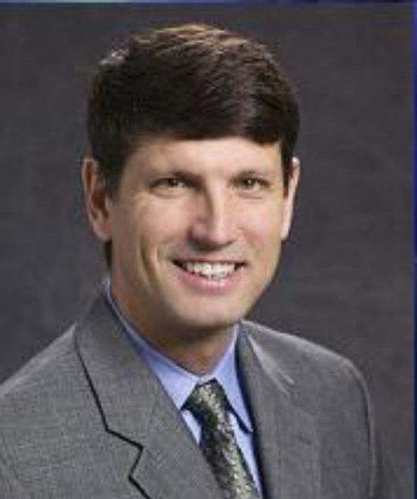
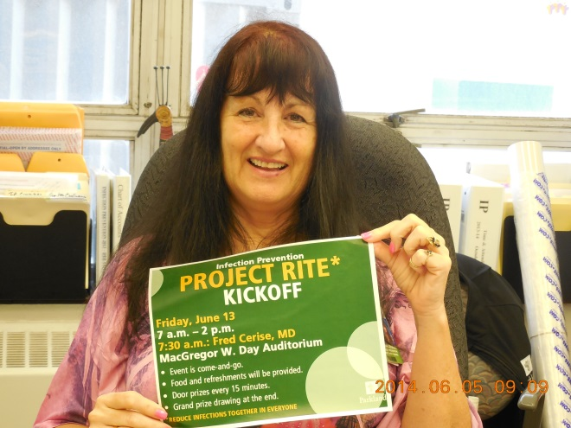
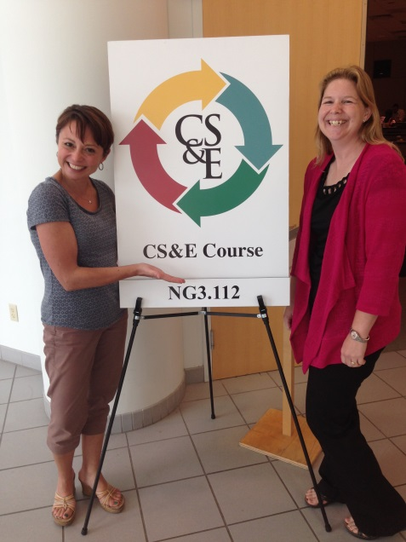
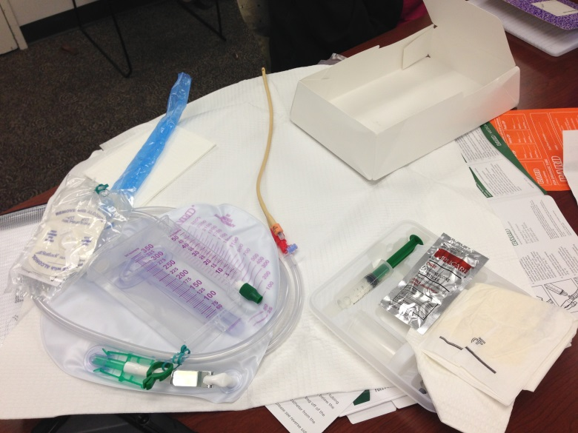
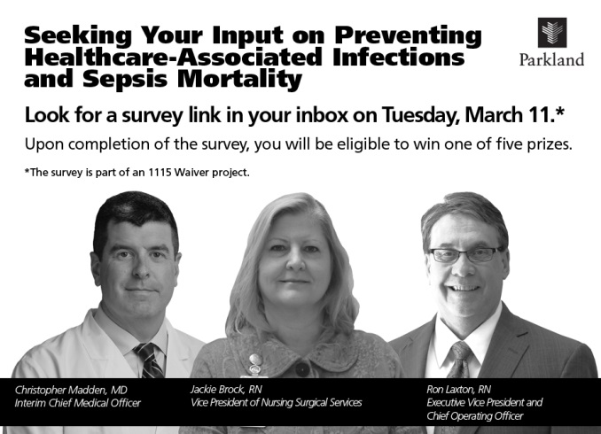

Slide 18
DO
4. Trained ~65 leaders in UTSW Clinical Safety & Effectiveness Program and ~340 employees in a 3-hr training on Key Quality and Safety concepts
5. Held 24 bi-weekly learning sessions with 1457 staff in attendance
6. Built referral process within electronic medical record for select clinical processes (e.g., referral to diabetes clinic for surgical patients at high risk of complications)
7. Used Business Objects/ SharePoint to store and share data reports between enterprise data reporting team and infection prevention

Slide 19
DO
8. Participated in RHP9 collaborative
9. Naming Contest
10. Project Kick-off event on June 13, 2014
11. Electronic survey of all clinicians and face-to-face interviews of key leaders across the system

Slide 20
STUDY: RITE PROGRAM
CATEGORY 3 OUTCOMES
Cumulative Outcomes | FY13 | FY14 | FY15 till date
CLABSI-ICUs&Wards Rate | 1.6 | 1.1 | 0.50
CLABSI-ICUs SIR | 0.35 | 0.47 | 0.53*
CAUTI-ICUs&Wards Rate | 4.7 | 2 | 1.7
CAUTI-Adult ICUs&8E SIR | 1.5 | 1.2 | 1.2*
SSI Overall Rate – 18 procedures | 3.4 | 2.8 | 1.1**
SSI-deep+organ/space Overall Rate- 18 procedures | 1.5 | 1.1 | 0.4**
SSI SIR – 8 reportable procedures | 1.55ŧ | 1.38ŧ | ----*
SSI deep+organ/space SIR – 8 reportable procedures | 0.635ŧ | 0.217ŧ | ----*
Sepsis Bundle Adherence POA in ED - Percent | 14 | 25.9 | 22.2%
Sepsis Mortality Adult – POA in ED - Percent | 6.9 | 6.3 | ---*
FY15 till date = Oct 2014 – Mar 2015
* 2nd Qtr FY15 reported in May
** Subject to change pending 90 day reviews
Ŧ Reporting for calendar year only

Slide 21
STUDY: RITE PROGRAM
CATEGORY 3 OUTCOMES

Slide 22
ACT
Implement change strategies that have not yet been completed (e.g., standardized curriculum and training)
Fine tune data reports and processes
Additional processes to reduce urinary catheter utilization and central line utilization
Complete implementation of infection control data mining software
Further improvements in adherence to processes

Slide 23
CHALLENGES AND LESSONS
Obtaining data from the EMR
Evolution of DSRIP rules
Working across multiple professional and service lines
Notes:
The primary challenge was obtaining process measure data on utilization of best practices implemented from the electronic medical record. This challenge resulted in delays in implementation of initiatives and delays in engagement of frontline clinicians because of delayed feedback. This challenge is being addressed through designating IT partners, making this effort an institutional priority and increased communication between IT partners and project leaders to allow two-way understanding of issues.
The second challenge is not having all the rules governing the project from the CMS/ HHSC at the time of beginning the project and evolution of the governing rules. This resulted in delays in implementation and in some cases change in direction (e.g., when sepsis mortality was replaced by sepsis bundle adherence as a category 3 measure). We addressed the challenge by having several email communications and also teleconference calls with the personnel at HHSC.
The third challenge is working across professions (e.g., nursing, IT, physicians) and service lines (e.g., medicine, surgery, emergency department). This challenge is being addressed through increased communication through multiple mechanisms.

Slide 24
PLAN FOR SUSTAINABILITY
Program, not Project
Branding: RITE - ‘Reduce Infections Together in Everyone’
Folding in workgroups and project initiatives into standing committee and departmental activities
Standing monthly data reports with clinical outcomes and process metrics data
Incorporating best practices into electronic medical record

Slide 25
Thank You! Questions?
Acknowledgements

Slide 26
Outpatient Antibiotic Therapy
Discharge Phone Calls
Maria J. Sierra RN

Slide 27
OPAT Discharge Phone Calls
Purpose
Adopt a proactive approach to patient’s transition to home
Review patient’s first home administration experience of IV antibiotic
Ensure patients have adequate supplies
Confirm that PICC dressing is intact
Reiterate follow up appointment & OPAT phone number
Answer patient questions
Assure patient of continuous support
Goals
Detect potential problems early after discharge
Prevent unnecessary visits to the ED
Avoid readmission to the hospital
Avoid possible complications
Encourage patient compliance
Maintain trusting relationship with patients

Slide 28
OPAT Discharge Phone Calls
Before
After
Patients missed a dose of antibiotics due to;
Not mixing the medication correctly or incorrectly storing the meds
Not receiving flushes from the pharmacy
Being unable to flush the PICC line
PICC dressing coming off
Missed OPAT follow up appointments
OPAT clinic phone number available to the patient for questions or concerns (Mon-Fri from 8:00 AM -5:00 PM)
OPAT RN is able to smooth the transition from hospital to home
OPAT RN guide the patient over the phone on the steps to mix IV antibiotics, review the dosage and proper storage
OPAT RN is able to help the patient obtain missing IV medications and supplies
OPAT RN gives instruction over the phone to troubleshoot PICC or set up appointment to de-clot the line
OPAT RN is able to see patient in the clinic and change the PICC dressing to prevent CLABSI
Increased show rate to OPAT first appointment
OPAT TC nurse available for questions or concerns Mon-Fri from 8:00 AM-5:00 PM & 24 hour RN line # given to patients, as well

Slide 29
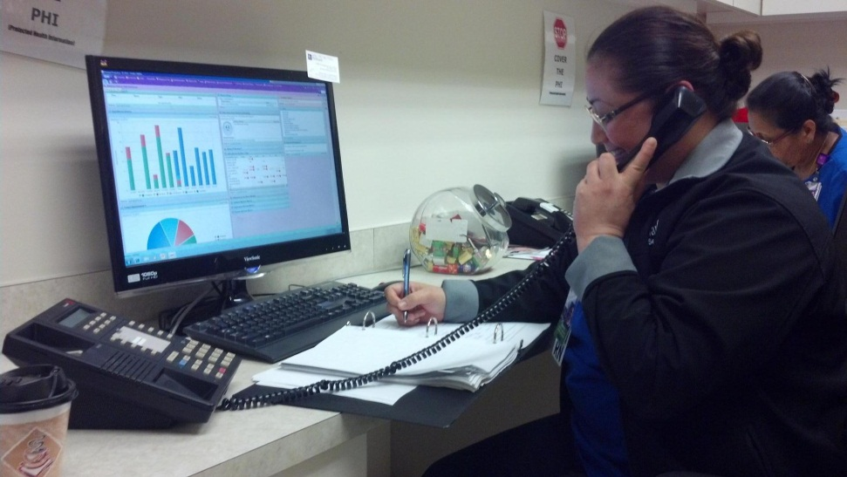
OPAT Discharge Phone Calls
OPAT RN Making Calls
Discharge Phone Call Questions
How are you doing with your IV abx? Have you had any problems with your infusions?
Do you have all the supplies you need for your IV abx?
Is your PICC line dressing still intact? Do you know how to cover your dressing to take a shower?
Remember you have an appt at the IV abx clinic on ____________.
If you have any questions or concerns about your IV abx or PICC line call 214-590-2297 or 214-590-0657.

Slide 30
OPAT Discharge Phone Calls
OPAT Discharge Log
Even though telephone encounters are entered in EPIC, a paper log is used during the call to allow for easy reference.

Slide 31
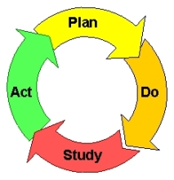
OPAT Discharge Phone calls
  Recognized multiple patients with similar concerns/problems after discharge home
  Created a questionnaire addressing common patient concerns
  Reviewed and approved the questionnaire with multidisciplinary team (Doctor, Pharmacist, OPAT RNs, Social Worker, Case Manager)
  Made a schedule of nurses making calls
  Identified patients going home on IV antibiotics
  Implemented calls to each OPAT patient within 48 hours of discharge
  Correct identified patient problems, including those experienced in other areas of the hospital
  Document a telephone encounter in EPIC
Plan
Do
  Added dialysis and SNF patients to
  call list due to inconsistencies with
  their medication administration
  Teach patients to expect a discharge
  phone call & actually review question
  list with them prior to their discharge
  Ensure a good contact # for the
  patient/caregiver is listed in EPIC if
  different from the emergency contact #
Act
Study
  Initially, only called self administration patients and home health patients received a call
  Experienced difficulty contacting patients
  Language line is used when needed
  Proactively address problematic issues that could lead to unnecessary readmission or ED visits

Slide 32
OPAT Discharge Phone Calls
Future Actions
Data will be kept and used to :
correlate the number of kept first follow up appointments.
track the number of possible complications that were averted.
track patient compliance & successes.
track readmissions to the hospital & ED visits.
develop a new tracking tool.

Slide 33
Thank You !!!
Questions?

Slide 34
OPAT Teaching Augmentation
Outpatient Parenteral Antibiotic Therapy Department (OPAT)
Mavis Mashingaidze

Slide 35
OPAT Teaching Augmentation
Goals
Make a visual tool available for patients to see (and reference) how to administer IV antibiotics at home
Efficient utilization of OPAT and floor RNs’ time by having patients watch OPAT video on their own
Provide an effective learning tool for a semi illiterate patient population
Be a national leader in providing OPAT to unfunded patients
Purpose
Compliment patients’ different learning styles (visual, auditory, verbal, logical)
Provide a visual tool for teaching how to administer IV antibiotics at home
Ameliorate the negative effects of low level education
Pilot OPAT program teaching

Slide 36
OPAT Teaching
Augmentation
  Performed IV antibiotic self-administration with one member documenting all the steps
  Reviewed all the steps noting repeated steps within the administration process
  Reviewed the steps with a multidisciplinary team (pharmacist, organizational effectiveness/video team, OPAT RNs)
  Distilled the steps to a script in flowchart format
  Went through each step of IV antibiotic administration
  Had organizational effectiveness team take video footage of the various steps
  Matched the script to the video footage
  Had a team member read the script as a voice over to match the video footage
  Conducted several meetings with to edit video
Plan
Do
  Liaised with pharmacy to obtain a QR code
  Conducted an in-service with floor
  RNs on how to download QR reader
  from a smart phone
  Conducted in-services on how to watch the OPAT video
  Started using the video to teach patients referred for OPAT
Act
Study
  EPIC review of OPAT doc flow sheet for patients who watched the video to reinforce teaching
  Review teaching in light of different learning styles
  Review teaching for infection prevention
  Review teaching for PICC care/maintenance
  Continuous reviews to identify areas of improvement

Slide 37
OPAT Teaching Augmentation
Before
Patients got overly anxious and felt overwhelmed by the antibiotic self-administration process – fear of the unknown
OPAT and Floor RNs spent lengthy periods trying to ensure that antibiotic administration at home is safe and avoid re-admissions for the same
Patients were reluctant to ask “dumb” questions
After
Patients are more comfortable with the antibiotic administration process after viewing the video
Patients feel empowered to take part in their own health care
There is evident compliance and adherence to the collaboratively formulated plan of care
Patients are more comfortable referring to a step in the video and asking relevant questions

Slide 38
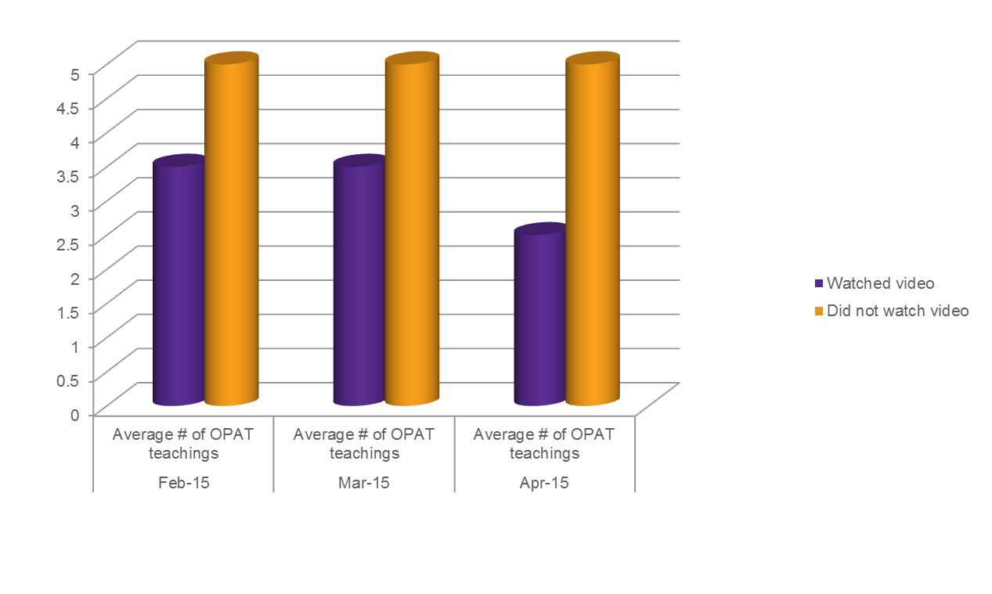
Results & Impact

Slide 39

Results & Impact continued
How to Administer Antibiotics Without an Infusion Pump
  https://www.youtube.com/watch?feature=player_embedded&v=w9BwrpVHE7k
  Our patients are brave after watching the OPAT video.

Slide 40

OPAT Teaching Augmentation
Questions
THANK YOU!

Slide 41
It is important to remember…
It often takes more than one cycle to achieve your objective.
By changing only 1 thing at a time you know the impact of your change.
Sometimes several changes are necessary to maximize the improvement you seek.

Slide 42
Keys to PDSA success
Be clear about your target objective
Make sure all participants are implementing the change as planned
Implement the change in a small portion of the agency
Study the results data before making a modification to the plan
Do not hesitate to start a new cycle when the data indicates or the team is convinced that a modification will improve results

Slide 43
And last…
Keep measuring and studying the results until you reach your objective and determine you have improved as much as you can.

Slide 44
Thank You
Next PDSA “Raise the Floor” Webinar:
Wednesday, August 5, 2015
Register at
texasRHP9.com>RHP9 Updates>Events

